Slide 1

CHAPTER 15
MACs and Signatures
Slides adapted from "Foundations of Security: What Every Programmer Needs To Know" by Neil Daswani, Christoph Kern, and Anita Kesavan (ISBN 1590597842; http://www.foundationsofsecurity.com). Except as otherwise noted, the content of this presentation is licensed under the Creative Commons 3.0 License.
Notes:
Welcome to SEC103 on Secure Programming Techniques. In this course, I assume that you have some background in computer security, but now you want to put that background to use. For example, in the Computer Security Principles and Introduction To Cryptography courses, we cover topics such concerning trust and encryption. In this course, we put these principles into to practice, and I’ll show you have to write secure code that builds security into your applications from the ground up.

Slide 2
Agenda
Secure Hash Functions
Message Authentication Codes (MACs)
  Block cipher based (CBC-MAC)
  Hash-function based (HMAC)
  Require sender & receiver to share key
Digital signatures – allows anyone (w/o shared key) to verify sender of message

Slide 3
15.1. Secure Hash Functions
Given arbitrary-length input, M, produce fixed-length output (message digest), H(M), such that:
Efficiency: Easy to compute H
One-Way/Pre-Image resistance: Given H(M), hard to compute M (pre-image)
Collision resistance: Hard to find M₁ ≠ M₂ such that H(M₁) = H(M₂)
H
M
MD=H(M)
Notes:
If you are coming from a computer science background, you may have heard of hash functions before. Hash functions, as used in the world of cryptography, have some similarities and differences from other types of hash functions. Like “regular” hash functions, a cryptographic hash function takes as input some (potentially large) message, M. It then computes a “message digest” h(M) that has the property that if two input message M1 and M2 are different, there is an overwhelmingly high probability that the two hashes h(M1) and h(M2) will be different. A hash function that simply adds the ASCII values of the characters in the message together does not have this property because “AB” and “BA” will have the same hash value even though they are different messages. Cryptographic hash functions use much more sophisticated techniques to ensure this property. The requirements that a cryptographic (secure) hash function must satisfy are three-fold:
Efficient. Computing h(M) must be very efficient.
One-way (Pre-Image Resistance). Given a message digest MD=h(M), it must be very hard to compute the original message, M.
Collision resistance. Given a message digest MD=h(M), it must be very hard to compute a second message, M’, such that its message digest h(M’) = MD.
MD = Message Digest

Slide 4
15.1. Secure Hash Functions Examples
Non-Examples:
  Add ASCII values (collisions): H('AB') = H('BA')
  Checksums CRC32 not one-way or collision-resistant
MD5: “Message Digest 5” invented by Rivest
  Input: multiple of 512-bits (padded)
  Output: 128-bits
SHA1: developed by NIST & NSA
  Input: same as MD5, 512 bits
  Output: 160-bits
Notes:
Two popular hash functions that are used in many systems are MD5 and SHA-1.

Slide 5
15.2. MACs
Used to determine sender of message
If Alice and Bob share key k, then Alice sends message M with MAC tag t = MAC(M,k)
Then Bob receives M’ and t’ and can check if the message or signature has been tampered by verifying t’ = MAC(M’, k)

Slide 6
15.2.1. CBC MACs
Encrypt message with block cipher in CBC mode
IV = 0, last encrypted block can serve as tag
Insecure for variable-length messages
0
M₁
M₂
M_{n}
+
+
+
…
k
AES
k
AES
k
AES
tag

Slide 7
15.2.2. HMAC
Secure hash function to compute MAC
Hash function takes message as input while MAC takes message and key
Simply prepending key onto message is not secure enough (e.g. given MAC of M, attacker can compute MAC of M||N for desired N)
Def:
  Where K is key k padded with zeros
  opad, ipad are hexadecimal constants

Slide 8
15.3. Signatures (1)
Two major operations: P, principal
  Sign(M, k) – M is message
  Verify(M, sig, P) – sig is signature to be verified
Signature: sequence of bits produced by Sign() such that Verify(M, sig, P) , (sig == Sign(M, k))
  Non-repudiable evidence that P signed M
  Many applications: SSL, to sign binary code, authenticate source of e-mail
Use asymmetric encryption ops F & F⁻¹

Slide 9
15.3. Signatures (2)
S() & V() : implement sign & verify functions
Signature is s = S(M, k_{s}) =F⁻¹(h(M), k_{s})
  Decrypt hash with secret key
  Only signer (principal with secret key) can sign
Verify s: V(M, s, k_{p}) = (F(s,k_{p}) == h(M))
  Encrypting with public key
  Allows anyone to verify a signature
  Need to bind principal’s identity to their public key

Slide 10
15.3.1. Certificates & CAs (1)
Principal needs certificate from CA (i.e. its digital signature) to bind his identity to his public key
CA must first sign own certificate attesting to own identity (“root”)
Certificate, C(P), stored as text: name of principal P, public key (k_{p(P)}), expiration date
C(P) = (C_{text}(P), C_{sig}(P))
Root Certificate, C(CA), looks like
  C_{text}(CA) = ("CA", k_{p(CA)}, exp)
  C_{sig}(CA) = S(C_{text}(CA), k_{s(CA)})

Slide 11
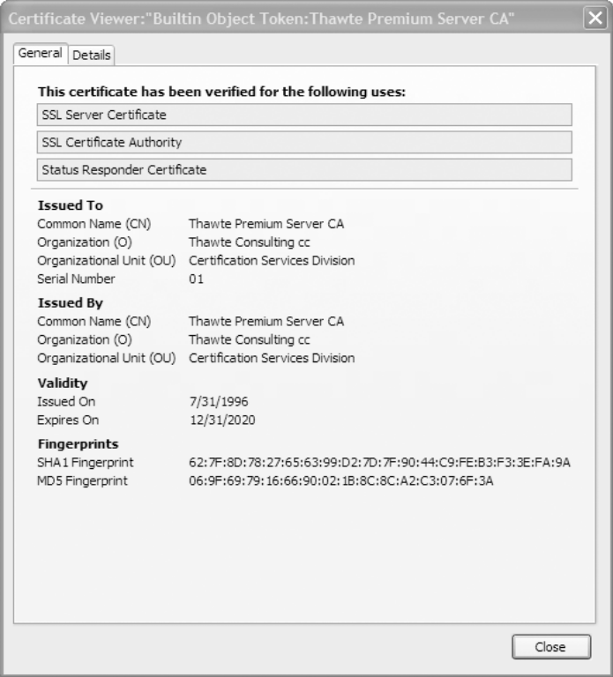
15.3.1. Certificates & CAs (2)
Alice constructs certificate text:
  C_{text}(Alice)=("Alice", k_{p(Alice)}, exp)
  Authenticates herself to CA (through “out-of-band” mechanism such as driver’s license)
CA signs Alice’s certificate:
C_{sig}(Alice)=S(C_{text}(Alice),k_{s(CA)})
Alice has public key certificate
  C(Alice)=(C_{text}(Alice),C_{sig}(Alice))
  Can use to prove that k_{p(Alice)} is her public key

Slide 12
15.3.2. Signing and Verifying
Signing: sig = Sign(M, k_{s(P)}) = (S(M, k_{s(P)}),C(P))
  Compute S() with secret key: sig.S
  Append certificate: sig.C
Verifying: Verify(M, sig, P) =
  V(M, sig.S, k_{p(P)}) &
  V(sig.C_{text}(P), sig.C_{sig}(P), k_{p(CA)}) &
  (C_{text}(P).name == P) &
  (today < sig.C_{text}(P).date)
signature verifies message?
signed by CA?
name matches on cert?
certificate not expired?

Slide 13
15.3.3. Registration Authorities
Authenticating every principal can burden CA
Can authorize RA to authenticate on CA’s behalf
  CA signs certificate binding RA’s identity to public key
  Signature now includes RA’s certificate too
  Possibly many intermediaries in the verification process starting from “root” CA certificate
  More links in chain, more weak points: careful when verifying signatures
Ex: IE would not verify intermediate certificates and trust arbitrary domains (anyone could sign)

Slide 14
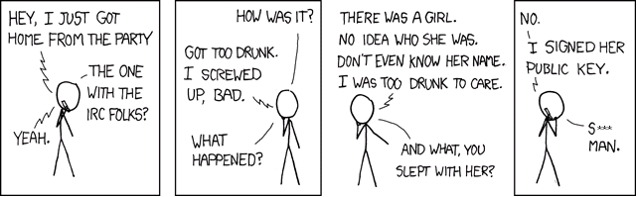
15.3.4. Web of Trust
Pretty Good Privacy (PGP): digital signatures can be used to sign e-mail
“Web of trust” model: users sign own certificates and other’s certificates to establish trust
Two unknown people can find a certificate chain to a common person trusted by both
Source:
http://xkcd.com/364/

Slide 15
15.4. Attacks Against
Hash Functions
Researchers have been able to obtain collisions for some hash functions
  Collision against SHA-1: 2⁶³ computations (NIST recommends phase out by 2010 to e.g. SHA-256)
  MD5 seriously compromised: phase out now!
Collision attacks can’t fake arbitrary digital signatures (requires finding pre-images)
However could get 2 documents with same hash and sign one and claim other was signed

Slide 16
15.5. SSL
Handshake: steps client & server perform before exchanging sensitive app-level data
Goal of handshake: client & server agree on master secret used for symmetric crypto
Two round trips:
  1st trip is “hello” messages: what versions of SSL and which cryptographic algorithms supported
  2nd varies based on client or mutual authentication

Slide 17
15.5.1. Server-Authenticated Only (1)
Client creates random pre-master secret, encrypts with server’s public key
Server decrypts with own private key
Both compute hashes including random bytes exchanged in “hello” to create master secret
With master secret, symmetric session key and integrity key derived (as specified by SSL)
App Data encrypted with symmetric key

Slide 18
15.5.1. Server-Authenticated Only (2)
Client
Server
ClientHello
ServerHello, Certificate, ServerHelloDone
ClientKeyExchange, ChangeCipherSpec, Finished
ChangeCipherSpec, Finished
Application Data

Slide 19
15.5.2. Mutual Authentication (1)
Client also sends own certificate to server
Sends CertificateVerify message to allow server to authenticate client’s public key
Pre-master secret set, compute master secret
Derive symmetric key & exchange data
SSL mechanisms prevent many attacks (e.g. man-in-the-middle) and has performance optimizations (e.g. caching security params)

Slide 20
15.5.2. Mutual Authentication (2)
Client
Server
ClientHello
ServerHello, Certificate, CertificateRequest, ServerHelloDone
Certificate, ClientKeyExchange, CertificateVerify,
ChangeCipherSpec, Finished
ChangeCipherSpec, Finished
Application Data

Slide 21
Summary
MACs - protect integrity of messages
  Compute tag to detect tampering
  Ex: CBC-MAC, HMAC (relies on secure hashes)
Signatures – binds messages to senders
  Allows anyone to verify sender
  Prevents forged signatures
  Use CAs to bind identities to public keys
  Or use Web of Trust model
Application: SSL (“Putting it all together”)
  Relies on Cryptography: symmetric & public-key
  And MACs & signatures

